Slide 1

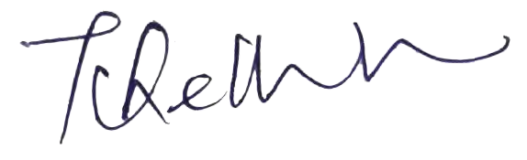
CUSTOMER BEHAVIOUR’S AND MARKET'S TRENDS ANALYSIS USING BASKET DATA
A project on
Submitted in partial fulfilment for the award of the degree of
by
ABHINAW KUMAR (19MCA0241)
Under the guidance of
Dr. CHELLATAMILAN T
Signature of Guide:

Slide 2

Introduction
A large number of people use to visit a shopping mall or shopping centers.
Large amount of data collected and stored as transections.
Those collected data can be use for a business prospective.

Slide 3

Objective
In the collected data we focus on which product is purchased most frequently by customers.
Generate the pattern of purchasing using best mining technique
Take a right decision which one another product can be combine with this
There are many techniques are available for this

Slide 4
SCOPE
It’s a intelligence technique to predict future purchase decisions of the customers.
Customers purchasing pattern.
Her/His line and unlike.
It will helpful to increase the sales
It will tell the market trends
It will also help to increase the production of particular items

Slide 5

BACKGROUND
Gathering records of customer basket or purchase items.
A data-set contain various information about customers
It is a process to finding useful information from the collected data.
For that first of we have to do data pre-processing means understand the data set and remove the unnecessary record from them.
Then we will apply the Association rule mining. Algorithms.

Slide 6
Association Rule Mining
Association rule mining can be thought as an if then relationship
First is if and second is then
A => B
If is also known as antecedent this an item and group of item that are typically found in the itemset.
Then is consequent this com along as an item with the antecedent group
If we have thousand of data then we can imagine how profit we can make that is why association rule mining is very good algorithm.
IF THEN

Slide 7
How to association rule mining works?
Association rule mining is all about the budling the rules. We have seen one rule that if A customer buy an item A then there is chance you might buy an it item B also
In this we find the relationship single two items is call single cardinality
But what about if a customer who bought the item A and B also want to buy item C or if a customer bought items A , B and C also want to bought item D , In this case cardinality will increase.
We can have lots of combination around this data .
Just imagine for thoued of data how many rules we have to create for each product
That’s why association rule mining has such measures we do not end up to create tens of thousand of rules. That is why Apriori algorithm comes in role.

Slide 8

Association Rul Mining
It is most useful algorithm for Market basket analysis.
There are three me components of this algorithm that help to measure the association
Support
Support is basically ratio of frequency of an item A or combination of items A and B and total number of combination we have purchase
Support
Confidence
Lift
Association Rule mining

Slide 9

Confidence
Confidence gives us how often a item A and B occurred together given the number of times a occurred. Now this also help us to solve lo of others problem because if somebody is buying A and B together and not buying C we can just rule out the C at that point of time. So we no need to analyse that what people bye barley according to this we can define our minimum support and confidence and fit into our algorithm and filter out our association rule.

Slide 10

Lift
Suppose after filtering we have like thousands of rule, this is practically we can’t thousand of rule for each item. So for that we need third measure called lift.
Lift is basically is strength of any rule. In the denominator of lift independent support value of A and B . It gives us independent occurrence probability of A and B. obesely a lot of difference between a random occurrence at association and if the denominator of lift is more it means that occurrence of randomness is more rather then occurrence because of any association .
So lift is final verdict whether we have to spent time this particular rule what we have got here or not .

Slide 11
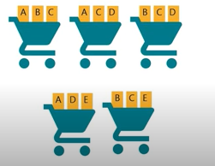
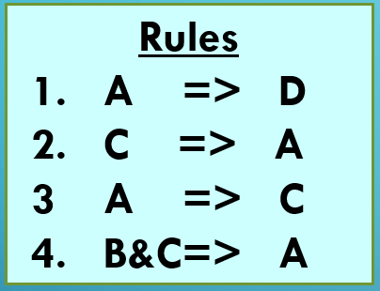
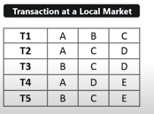
Suppose we have set of item A, B, C, D, and E and set of transaction transection T1, T2, T3, T4, and T5.
Suppose we have created some rule such as
Then the support , confidence and lift value are according to these rules
Rules | Support | Confidence | Lift
A=>D | 2/5 | 2/3 | 10/9
C=>A | 2/5 | 2/4 | 5/6
A=>C | 2/5 | 2/3 | 5/6
B&C=>A | 1/5 | 1/3 | 5/6

Slide 12
Apriori Algorithm
Apriori algorithm uses the frequent item set to generate the association rule and it is based on the concept that subset of frequent item set must be frequent item set it self.
Frequent Item set:- A frequent item set is am item set whose support value is greater then threshold value. That is minimum support as well as confidence decide by marketing team according to the sales. Ex- If A&B is a frequent item set then A and B should also be a frequent itemset individually.
Suppose we have 5 transection and
minimum support count = 2 and
minimum confidence value is 60%
Transection ID | items
T1 | 1 2 3
T2 | 2 3 5
T3 | 1 2 3 5
T4 | 2 5
T5 | 1 3 5

Slide 13
Apriori Cont.
So fir step is to create itemset size of one and calculate there support value
Now here as you can se item 4 support count is laser then minimum support so we have to eliminate it,
F1 Table
Transection ID | items
T1 | 1 3 4
T2 | 2 3 5
T3 | 1 2 3 5
T4 | 2 5
T5 | 1 3 5
Itemset | items
1 | 3
2 | 3
3 | 4
4 | 1
5 | 4
Itemset | items
1 | 3
2 | 3
3 | 4
4 | 1
5 | 4
F1 Table
Itemset | items
1 | 3
2 | 3
3 | 4
5 | 4
F!

Slide 14
Now we have to create item set of size two using rest item after eliminating 4 and calculate the support value
F2 Table
Itemset | support
{ 1 2} | 1
{ 1 3} | 3
{ 1 5} | 2
{ 2 3} | 4
{2 5} | 3
{3 5} | 3
Transection ID | items
T1 | 1 3 4
T2 | 2 3 5
T3 | 1 2 3 5
T4 | 2 5
T5 | 1 3 5
Now again we have to eliminate itemset {1 2 } because support count is laser then threshold value
F2 Table
F2 Table
Itemset | support
{ 1 2} | 1
{ 1 3} | 3
{ 1 5} | 2
{ 2 3} | 4
{2 5} | 3
{3 5} | 3
Itemset | support
{ 1 3} | 3
{ 1 5} | 2
{ 2 3} | 4
{2 5} | 3
{3 5} | 3

Slide 15
Now we have to create item set of size three and calculate the support value. All the combination of itemset F2 for this particular iteration.
Transection ID | items
T1 | 1 3 4
T2 | 2 3 5
T3 | 1 2 3 5
T4 | 2 5
T5 | 1 3 5
F3 Table
Itemset | support
{ 1 2 3} | 1
{ 1 2 5} | 1
{ 1 3 5} | 2
{2 3 5} | 2
Similarly here we have to eliminate {1 2 3} and { 1 2 5}
Itemset | support
{ 1 2 3} | 1
{ 1 2 5} | 1
{ 1 3 5} | 2
{2 3 5} | 2
Itemset | support
{ 1 3 5} | 2
{2 3 5} | 2

Slide 16
Now we have to create item set of size four and calculate the support value. All the combination of itemset F3 will be use for this particular iteration.
Transection ID | items
T1 | 1 3 4
T2 | 2 3 5
T3 | 1 2 3 5
T4 | 2 5
T5 | 1 3 5
F4 Table
Itemset | support
{ 1 2 3 5} | 1
F4 Table
Here this is the last item set and its support count is laser then minimum support count so we have to go for previous item set that is F3
Itemset | support
{ 1 3 5} | 2
{2 3 5} | 2

Slide 17
Now for each item set we have to create non empty subset
So all possible rule for I1 are
Rule 1: 1 &3 => 5
So confidence of Rule 1 = = 2/3= 66.66%
Confidence of Rule 1 > Minimum confidence
So rule 1 is selected
F4 Table
For I1 ={1 3 5} subset are {1,3}, {1,5}, {3 ,5}, {1}, {3}, {5}
For I2 ={2 3 5} subset are {1,3}, {1,5}, {3 ,5}, {1}, {3}, {5},
Itemset | support
{ 1 3 5} | 2
{2 3 5} | 2
Support(1,3,5)
Support(1, 3)

Slide 18
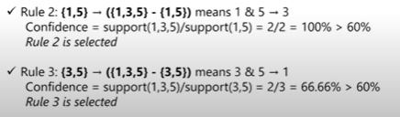
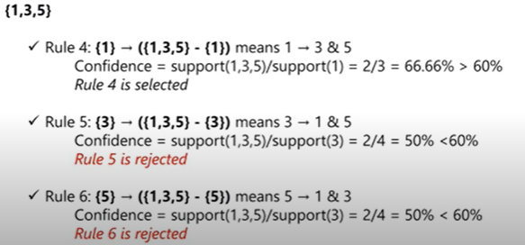
Similarly
Similarly For I2

Slide 19
Conclusion And Future work
It helps us after implementation to know our customer behaviour but still there is a problem in it consider only minimums support and confidence to find purchasing patterns. It does not provide some flexibility. Means if we are finding the rule for support value 0.02% and confidence value 60% it will not consider the value which is leaser then it but nearest. So, to overcome this type of drawback we should do some change in apriori and merge with fussy algorithm for finding the better rule with some flexibility. It will improve our seals and also help to customer to product selection. It may not be for every customer actual demand but it will help us to know most nearly their demand for maximum customer.

Slide 20
Thank You !
Abhinaw Kumar(19MCA0241)

